Slide 1
MEET YOUR INSTRUCTOR
AZEEM UMAR
TECHNICAL PROFILE & TIMELINE
Assistant Professor | Business Academy Aarhus (2024 – Present)
Focus: Enterprise Networking, Google Cloud, Veeam Backup Infrastructure
Systems Instructor | Mercantec (2009 – 2024)
Specialist: Windows Server Infrastructure, SQL Databases, Exchange, & System Center.
Systems Engineer | NADRA (2005 – 2006)
Role: Enterprise administration on Microsoft server architectures.
Linkedin Profile:
https://www.linkedin.com/in/azeem-umar-39a53945/

Slide 2
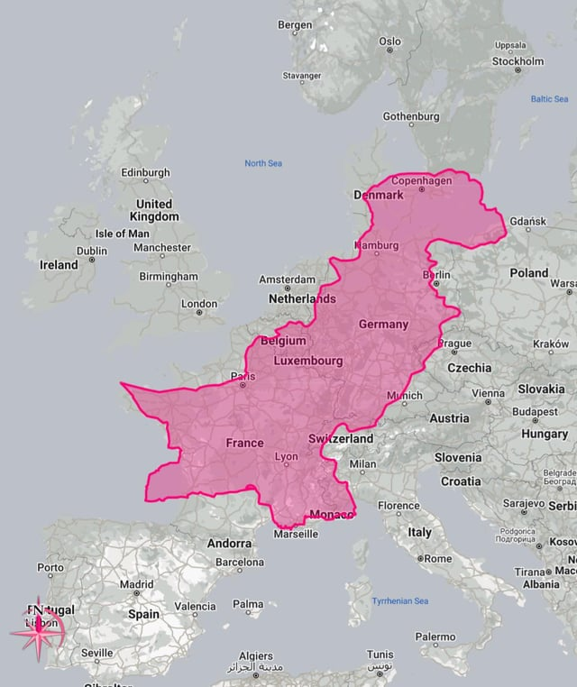

Slide 3
WELCOME TO NT2 ROUTING (SEMESTER 2)
Enterprise Architecture: Deploying a Multi-Subnet Production Core
• Weeks 1 - 2: Virtual Switches & Master Image Deployments
• Weeks 3 - 4: Core LAN Routing, NAT Firewalls, & Secure SSH Routing
• Weeks 5 - 6: DHCP and Relay Agent Routing & DNS Nameservers
• Weeks 7 - 8: Apache Web Server Routing, Samba Storage, & Rsync Backups
• Week 9: Cross-Platform Windows Static Routing

Slide 4
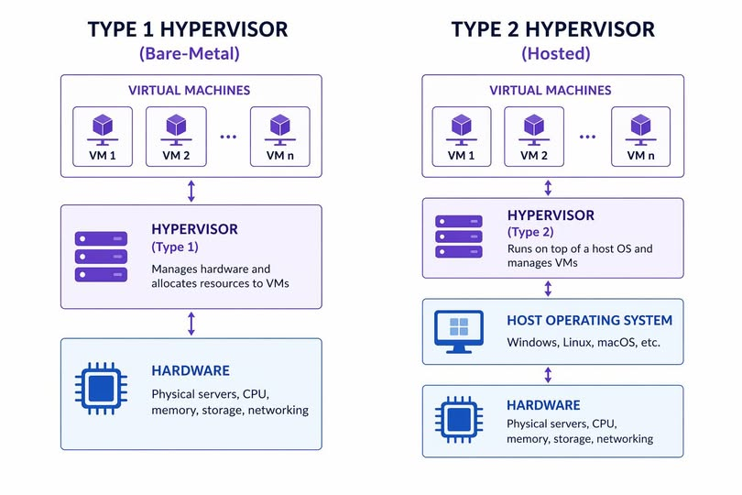

Slide 5
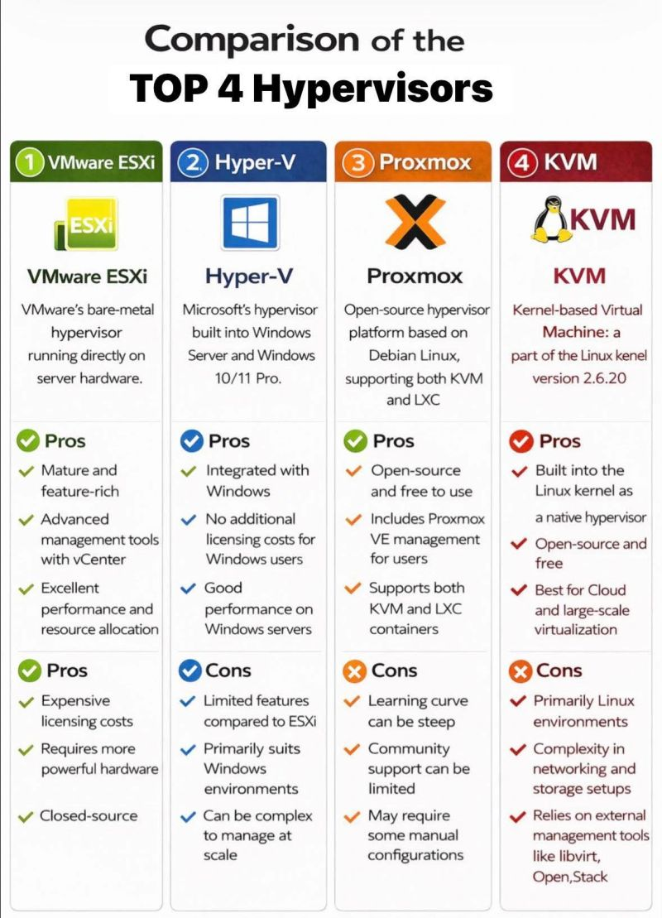

Slide 6
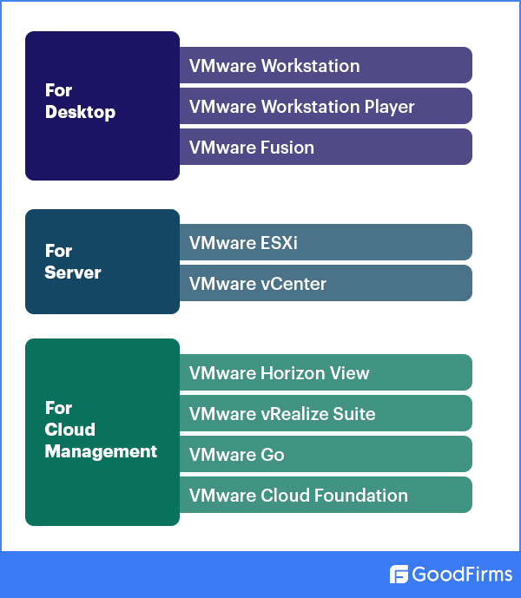

Slide 7
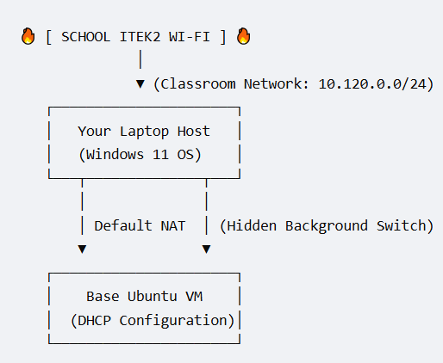
Lesson 1 Infrastructure — The Single-VM Sandbox

Slide 8
Group Workflow — Sourcing, Sharing, & Cloning Templates
[ PHASE 1: DOWNLOAD ] ──► Only Student 1 downloads Server & Desktop ISOs
│
▼
[ PHASE 2: INSTALL ] ──► Student 1 builds baseline Master Template folders
│
▼
[ PHASE 3: O-T-A SHARE]──► Student 1 shares folders over local Wi-Fi
(Students 2, 3, 4 drag folders to local storage)
│
▼
[ PHASE 4: CLONING ] ──► EVERY individual registers file & generates a
"Linked Clone" with a fresh MAC ID ("I COPIED IT")

Slide 9
Ubuntu Netplan configuration
DHCP
Fixed IP addresses Manual routes

Slide 10
Netplan file handling
Directory:
cd /etc/netplan
Ls
List content of file:
cat /etc/netplan/00-installer-config.yaml
Backup config file:
sudo cp 00-installer-config.yaml 00-installer-config.yaml.bak

Slide 11
Modifying config file
sudo nano 00-installer-config.yaml
Testing config:
Verify syntax:
sudo netplan generate
Test config for 120 seconds
sudo netplan try
Permanently applying config:
sudo netplan apply

Slide 12
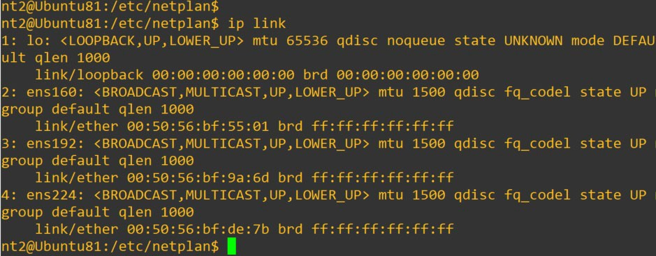
Finding interface ID’s in Ubuntu
Ip link

Slide 13
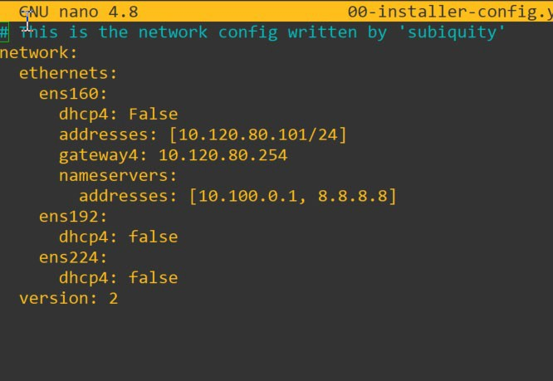
Configure DHCP for interface

Slide 14
Configure fixed IP addr. for interface

Slide 15
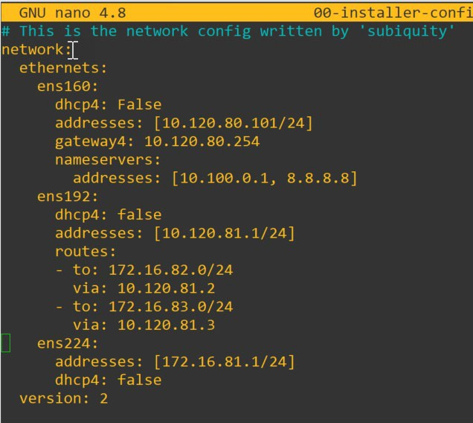
Configure IP routes.

